Slide 1
Data Stucture and Algorithms
Dr. Fidaa Abed

Slide 2
Importance of Data Structures and Algorithms
In every computer science curriculum
Improve quality of life
Even save lives

Slide 3
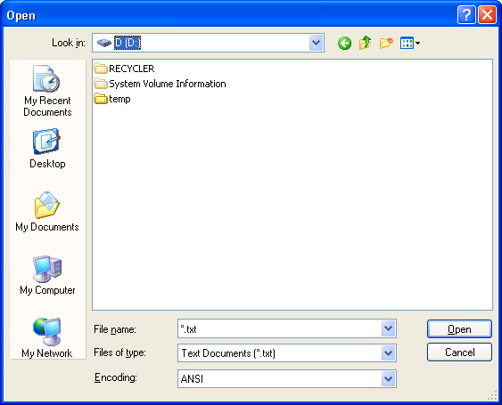
Application of Data Structure and Algorithms
Open a file

Slide 4
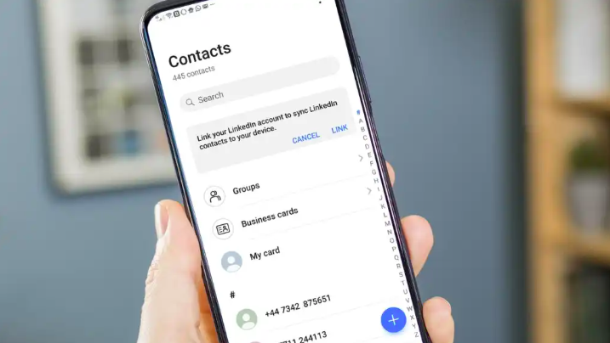
Application of Data Structure and Algorithms
Look up a contact in the phone

Slide 5
Application of Data Structure and Algorithms
Log in

Slide 6
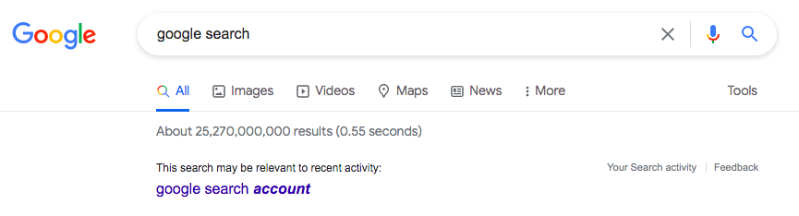
Application of Data Structure and Algorithms
Google search

Slide 7

Application of Data Structure and Algorithms
Medical records

Slide 8
The Need for Efficiency
Google search
35 trillion page
1 GHz processor: 1 billion instructions per second
We need at least 35000 seconds
Traditional search: 9 hours/search
Using Data Structure and Algorithms: 1 second/search

Slide 9
The Need for Efficiency
Using Data Structure and Algorithms: 1 second/search???
How is that possible
Smart data structures + efficient Algorithms

Slide 10
Example

Slide 11
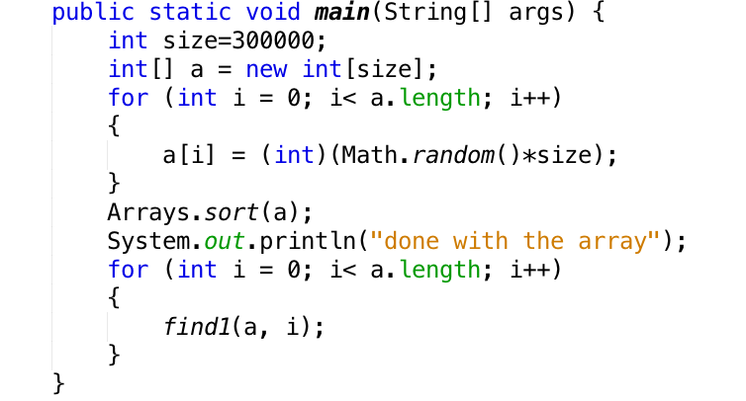

Slide 12
